Slide 1
Using Twitter Bootstrap

Slide 2
Objectives
In this session, you will learn to:
  Work with Bootstrap

Slide 3




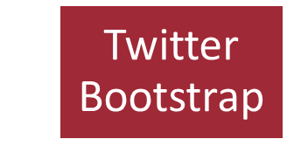


Introducing Bootstrap
Scenario:
Wants to create a responsive website
Frustrated with a lot of HTML and CSS code
What if you get ready-made pieces of code
Saves a lot of time and effort, but from where to get these code
You can get these code from

Slide 4
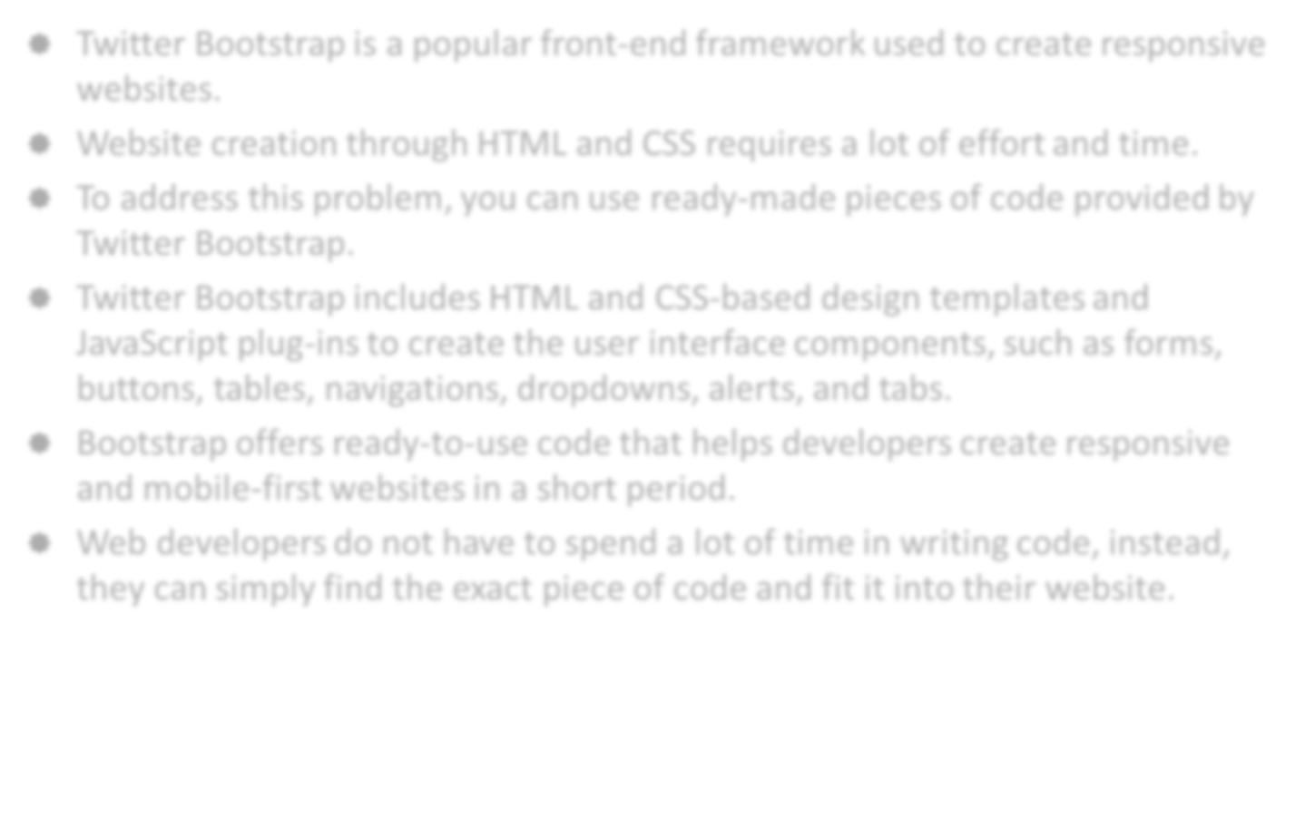
Introducing Bootstrap (Contd.)
Twitter Bootstrap is a popular front-end framework used to create responsive websites.
Website creation through HTML and CSS requires a lot of effort and time.
To address this problem, you can use ready-made pieces of code provided by Twitter Bootstrap.
Twitter Bootstrap includes HTML and CSS-based design templates and JavaScript plug-ins to create the user interface components, such as forms, buttons, tables, navigations, dropdowns, alerts, and tabs.
Bootstrap offers ready-to-use code that helps developers create responsive and mobile-first websites in a short period.
Web developers do not have to spend a lot of time in writing code, instead, they can simply find the exact piece of code and fit it into their website.
Use the animation, RWD_08_IntroducingBootstrap, to understand the concept of Twitter Bootstrap.

Slide 5
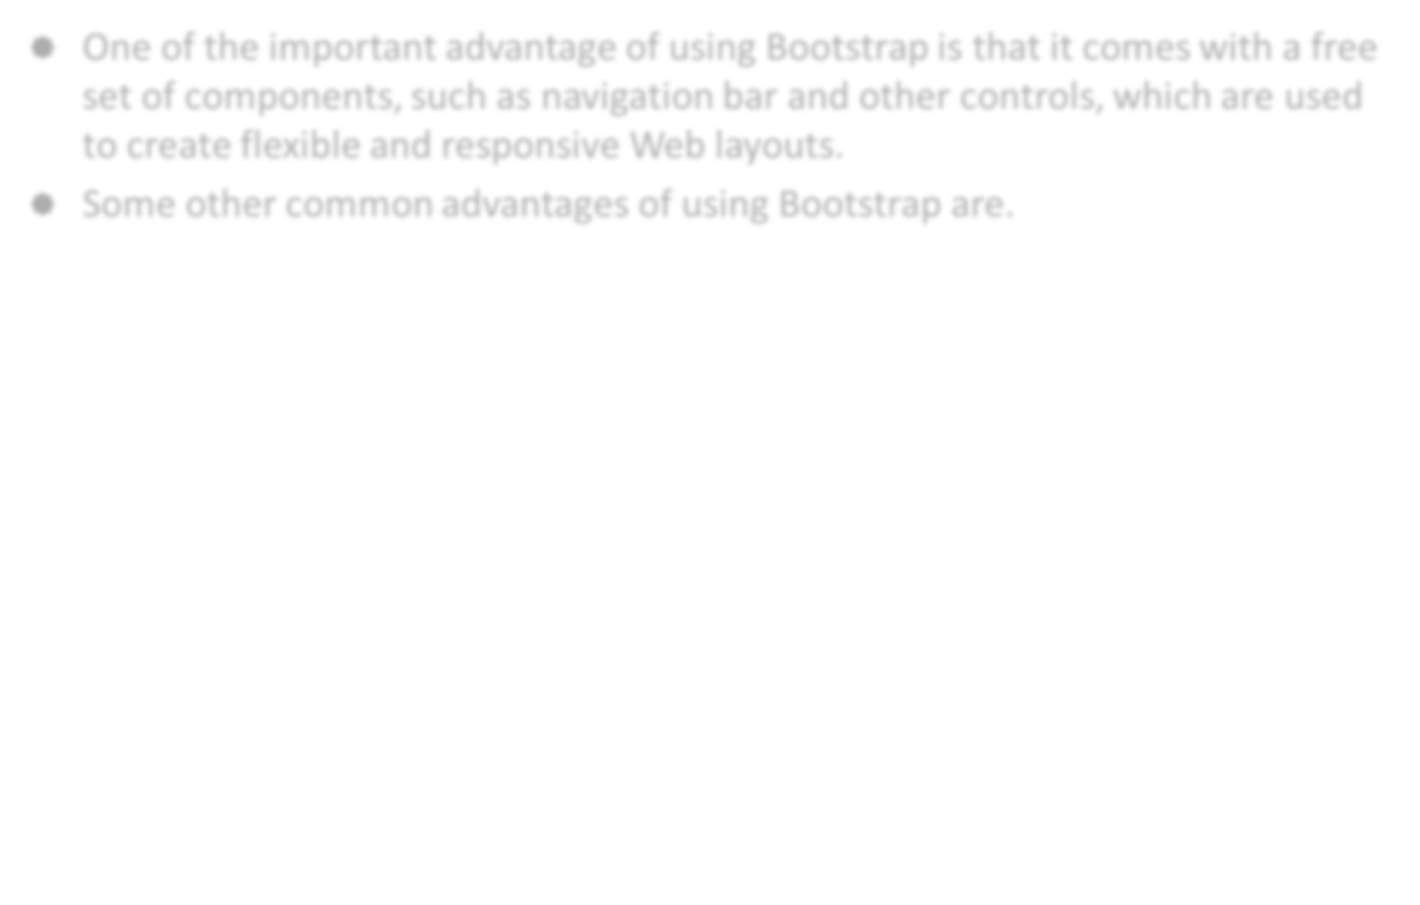
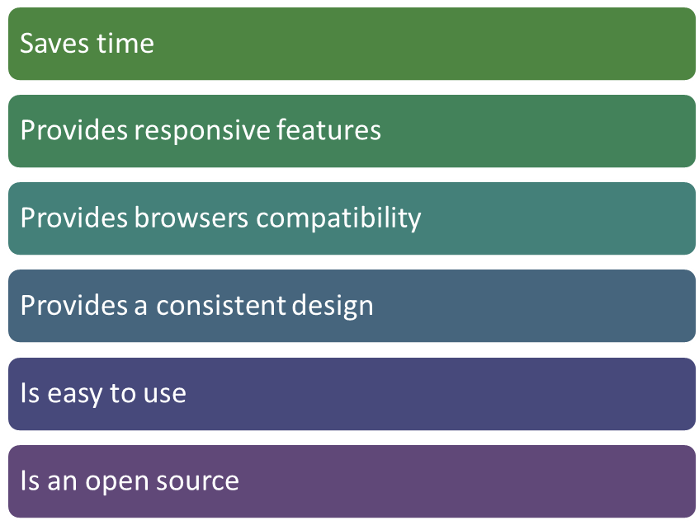
Advantages of Bootstrap
One of the important advantage of using Bootstrap is that it comes with a free set of components, such as navigation bar and other controls, which are used to create flexible and responsive Web layouts.
Some other common advantages of using Bootstrap are.

Slide 6
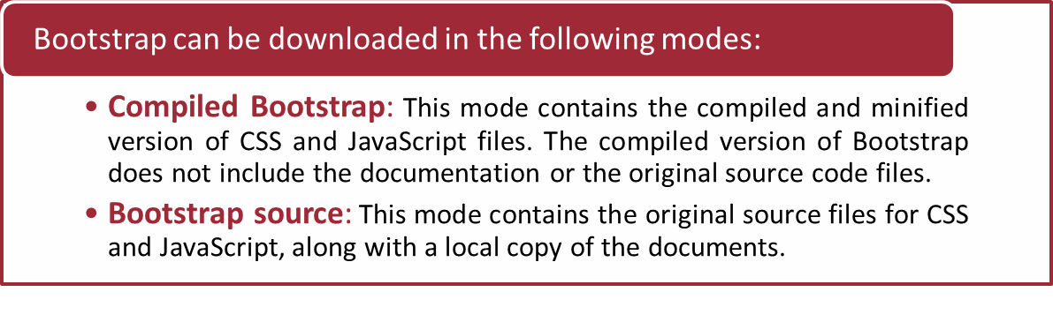
Getting Started with Bootstrap
To use Bootstrap, you first need to download it and understand its file structure.

Slide 7
Getting Started with Bootstrap (Contd.)
The following figure shows the the file directory structure for compiled Bootstrap.
The following figure shows the file directory structure for Bootstrap source.
bootstrap/
├── css/
│ ├── bootstrap.css
│ ├── bootstrap.min.css
│ ├── bootstrap-theme.css
│ └── bootstrap-theme.min.css
├── js/
│ ├── bootstrap.js
│ └── bootstrap.min.js
└── fonts/
├── glyphicons-halflings-regular.eot
├── glyphicons-halflings-regular.svg
├── glyphicons-halflings-regular.ttf
└── glyphicons-halflings-regular.woff
bootstrap/
├── less/
├── js/
├── fonts/
├── dist/
│ ├── css/
│ ├── js/
│ └── fonts/
└── docs/
└── examples/

Slide 8
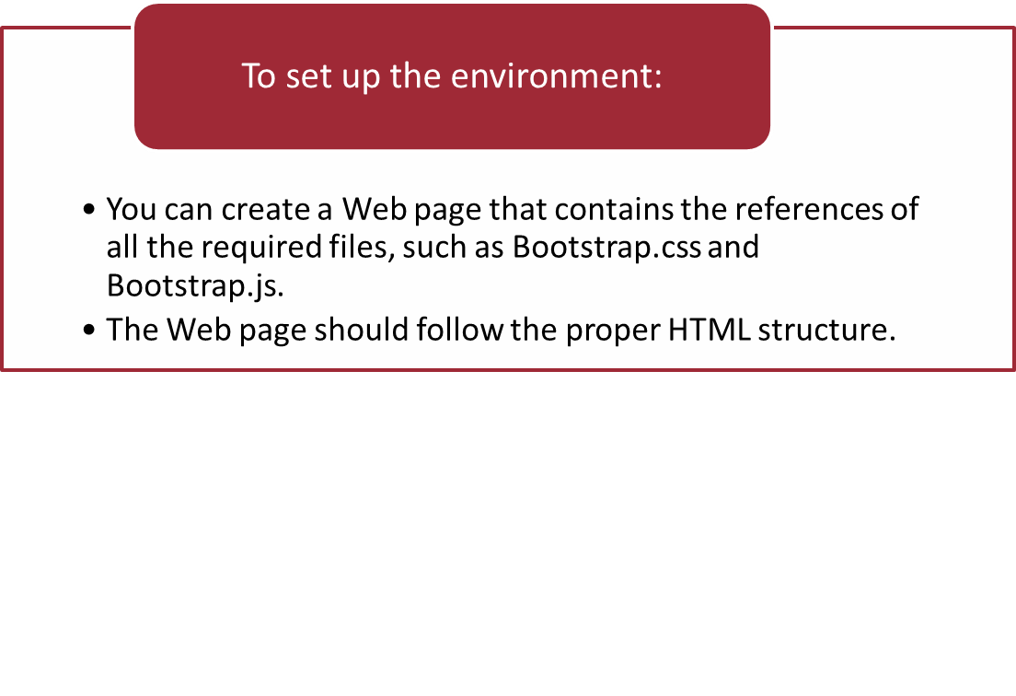
Creating a Basic Bootstrap Web Page
Bootstrap provides ready-made pieces of code for a variety of UI elements.
To use these UI elements in your Web page, you need to include the
ready-made pieces of code in your Web page.
You need to set up the required environment in which the code will work.

Slide 9
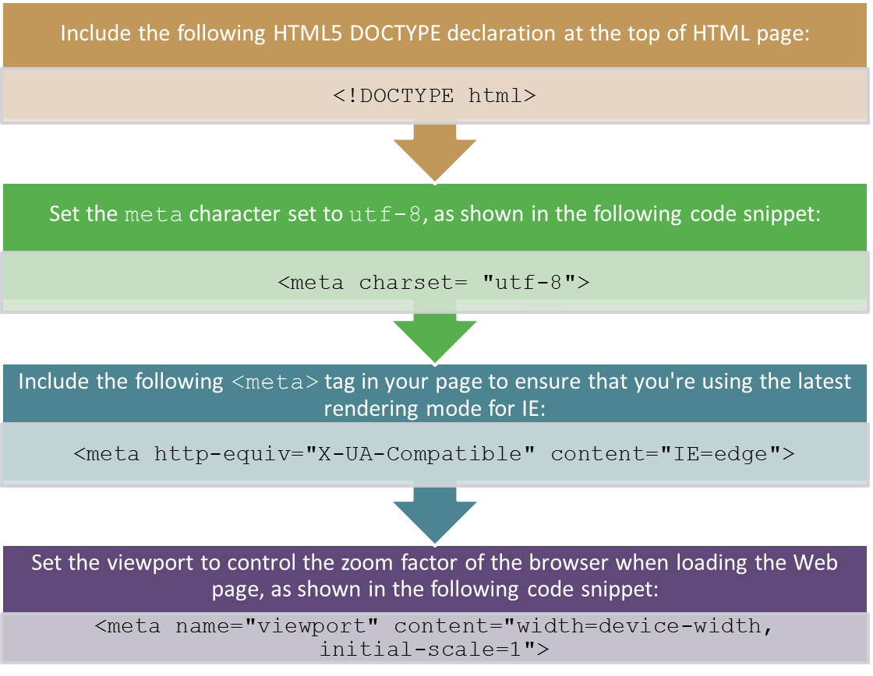
Creating a Basic Bootstrap Web Page (Contd.)
To create a Web page in Bootstrap, you should perform the following steps:

Slide 10
Creating a Basic Bootstrap Web Page (Contd.)
The following code snippet depicts the basic Bootstrap Web page:
<!DOCTYPE html>
<html lang="en">
<head>
<meta charset="utf-8">
<meta http-equiv="X-UA-Compatible" content="IE=edge">
<meta name="viewport" content="width=device-width, initial-scale=1">
<title>Basic Bootstrap Web Page </title>
<!-- Bootstrap -->
<link href="css/bootstrap.min.css" rel="stylesheet">
</head>
<body>
<h1>Hello, world!</h1>
<!-- jQuery (necessary for Bootstrap's JavaScript -ins) -->
<script src="js/jquery-2.1.1.min.js"></script>
<!-- Include all compiled plug-ins (below), or include individual files as needed -->
<script src="js/bootstrap.min.js"></script>
</body>
</html>

Slide 11
Creating and Executing Basic Bootstrap Template
Let us see how to create and execute basic Bootstrap Template.

Slide 12
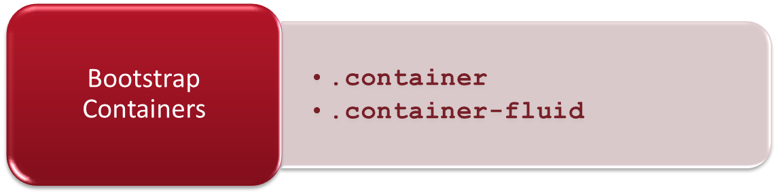
Understanding Grid System
In a graphic design, a grid is a structure made up of a series of intersecting straight lines used to structure content.
In the website development process, it is used to create the Web page layouts in the form of rows and columns that contain the website content.
Bootstrap uses a grid system that is based on a 12-column grid, where:
  The width of each component of a Web page is specified in terms of the number of columns it occupies.
  The width of any component cannot be more than 12 columns.
Bootstrap includes predefined classes that enable you to easily specify the layout.
Bootstrap requires a container to wrap everything contained in the Web page and to house the grid system.

Slide 13
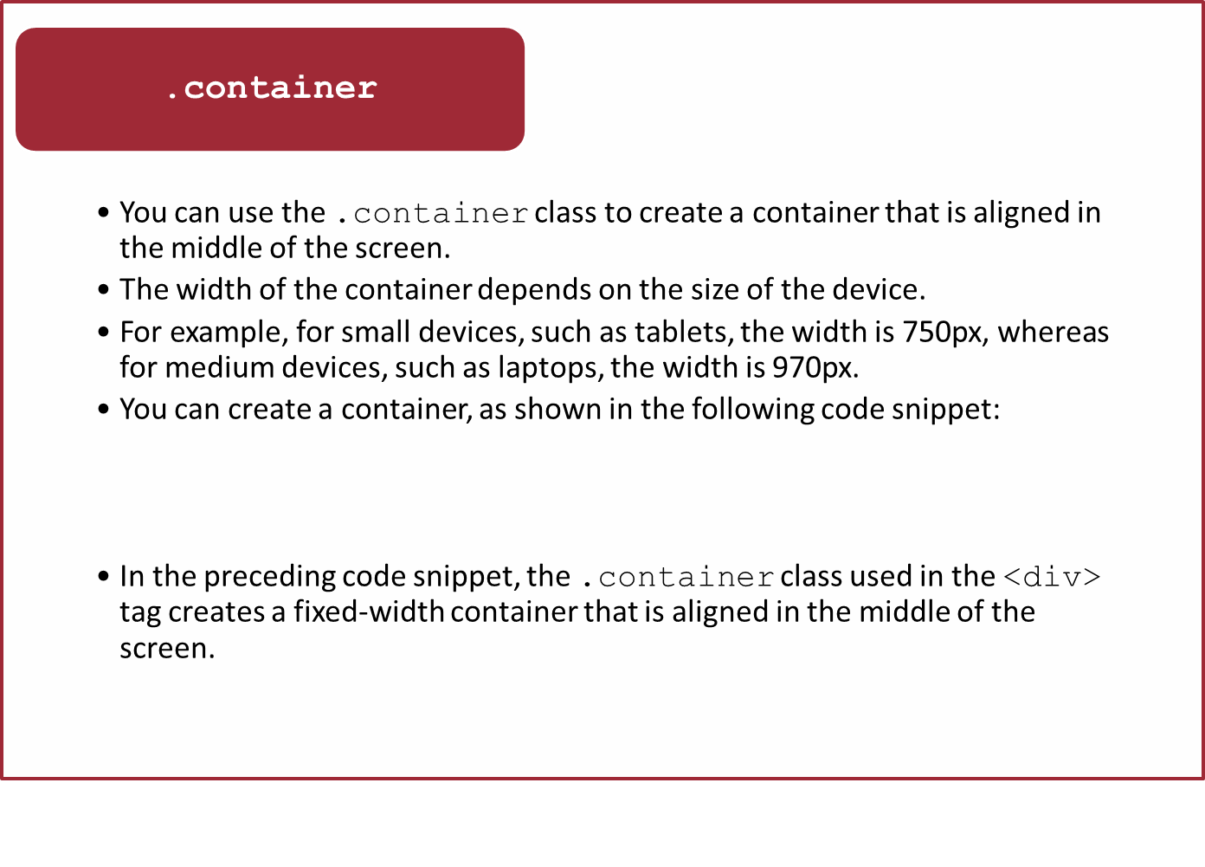
Understanding Grid System (Contd.)
<div class="container">
<h1>Hello, world!</h1></div>

Slide 14
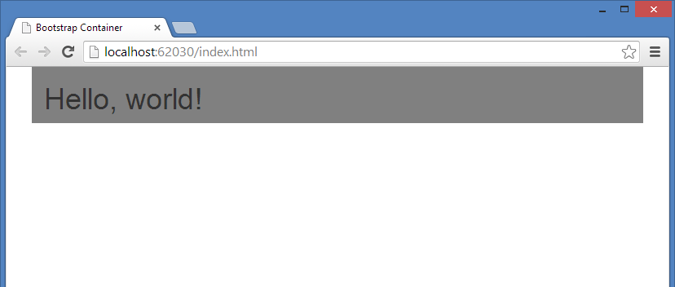
Understanding Grid System (Contd.)
Add the following code snippet in your stylesheet to set the
background-color property of the .container class:
On the execution of the preceding code snippet, the Hello,world! message will be displayed in the fixed width, as shown in the following figure.
.container
{background-color: #808080;}

Slide 15
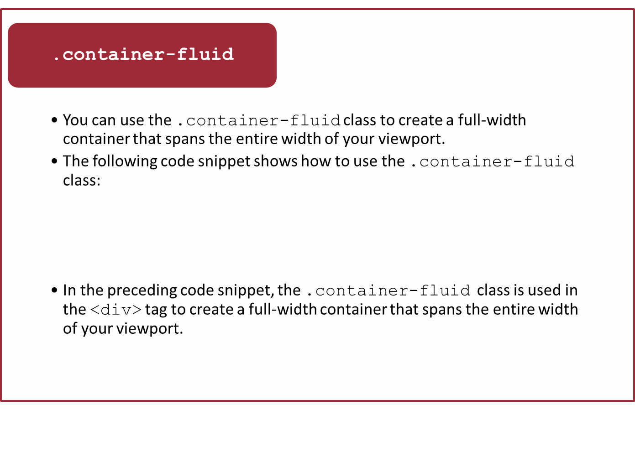
Understanding Grid System (Contd.)
<div class="container-fluid">
<h1>Hello, world! </h1></div>

Slide 16
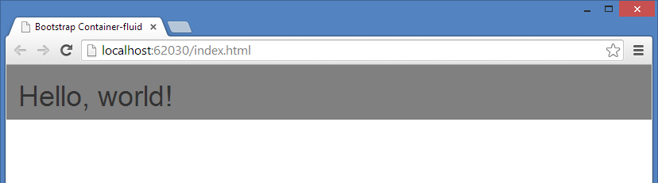
Understanding Grid System (Contd.)
Add the following code snippet in your stylesheet to make the page container more presentable:
On the execution of the preceding code snippet, the background-color property of the .container-fluid class will be set as shown in the following figure.
.container-fluid
{background-color: #808080;}

Slide 17
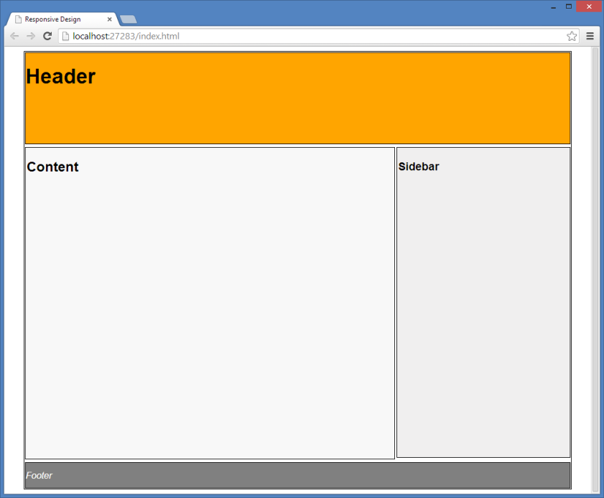
Understanding Grid System (Contd.)
The layout of a Web page is usually created in the form of rows and columns, as shown in the following figure.
In the preceding figure, the layout is divided into three rows. Further, one of the rows is divided into two columns.
To create this type of layout using Bootstrap, you first need to create a container. Thereafter, you can add rows to the container.

Slide 18
Understanding Grid System (Contd.)
For this, you can use the .row class, as shown in the following code snippet:
<div class="container">
<div class="row" id="siteheader">
<h1> Header</h1>
</div>
<div class="row" id="contentsection">
<h3> Content</h3>
</div>
<div class="row" id="sitefooter">
<h5> Footer</h5>
</div>
</div>

Slide 19
Understanding Grid System (Contd.)
To see rows on a Web page properly, apply some style to the Web page, as shown in the following code snippet:
.container
{
border: 1px solid black;
}
#siteheader
{
background-color: orange;
height: 130px;
}
#contentsection
{
background-color: #fff;
height:500px;
}
#sitefooter
{
background-color: darkgray;
height: 50px;
}

Slide 20
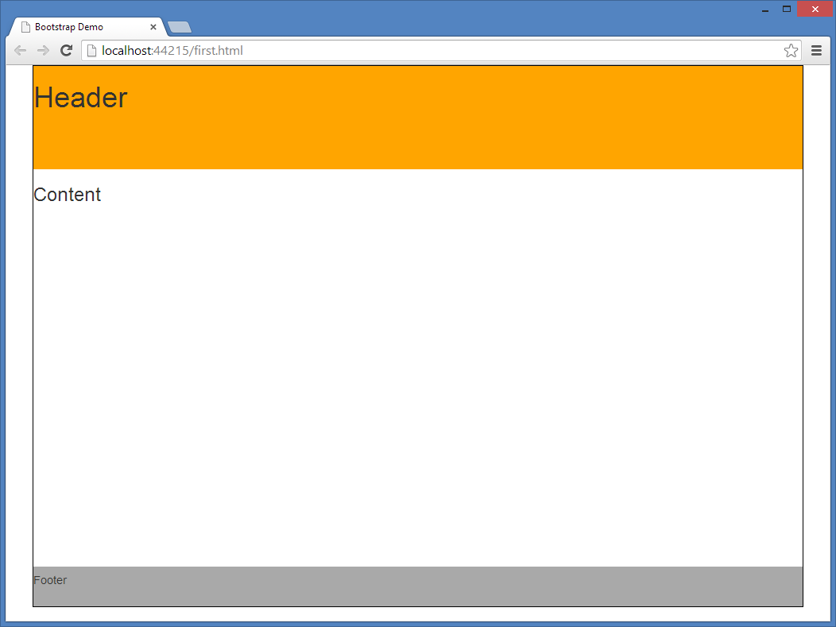
Understanding Grid System (Contd.)
On the execution of the preceding code snippet, the Web page appears, as shown in the following figure.

Slide 21
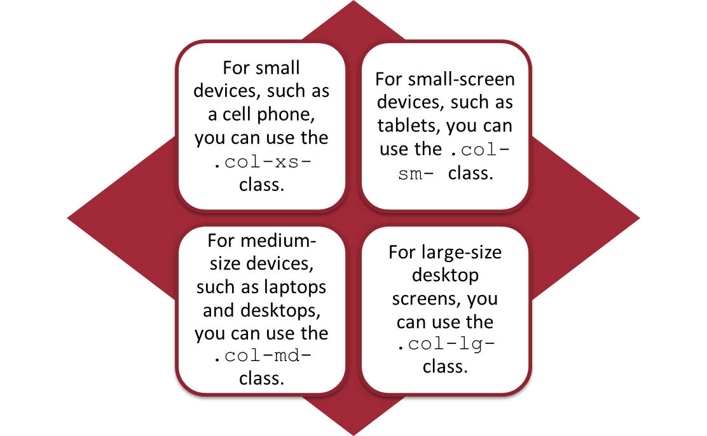
Understanding Grid System (Contd.)
To split rows into columns, Bootstrap provides several predefined classes, such as .col-xs-, .col-sm-, .col-md-, and .col-lg-.
These classes help you make grid layouts easily and quickly for different types of devices, such as cell phones, tablets, laptops, and large desktops.
For instance:

Slide 22
Understanding Grid System (Contd.)
The following table summarizes some of the key features of the new grid system for devices of different sizes.
Features of Bootstrap 3 Grid System | Extra Small Devices Phones (<768px) | Small Devices Tablets (≥768px) | Medium Devices Desktops (≥992px) | Large Devices Desktops (≥1200px)
Number of column | 12 | 12 | 12 | 12
Container width | None (auto) | 750px | 970px | 1170px
Class prefix | .col-xs- | .col-sm- | .col-md- | .col-lg-
Column width | Auto | ~62px | ~81px | ~97px
Gutter (gaps between column content) width | 15px on each side of a column (i.e. 30px) |  | 15px on each side of a column (i.e. 30px)

Slide 23
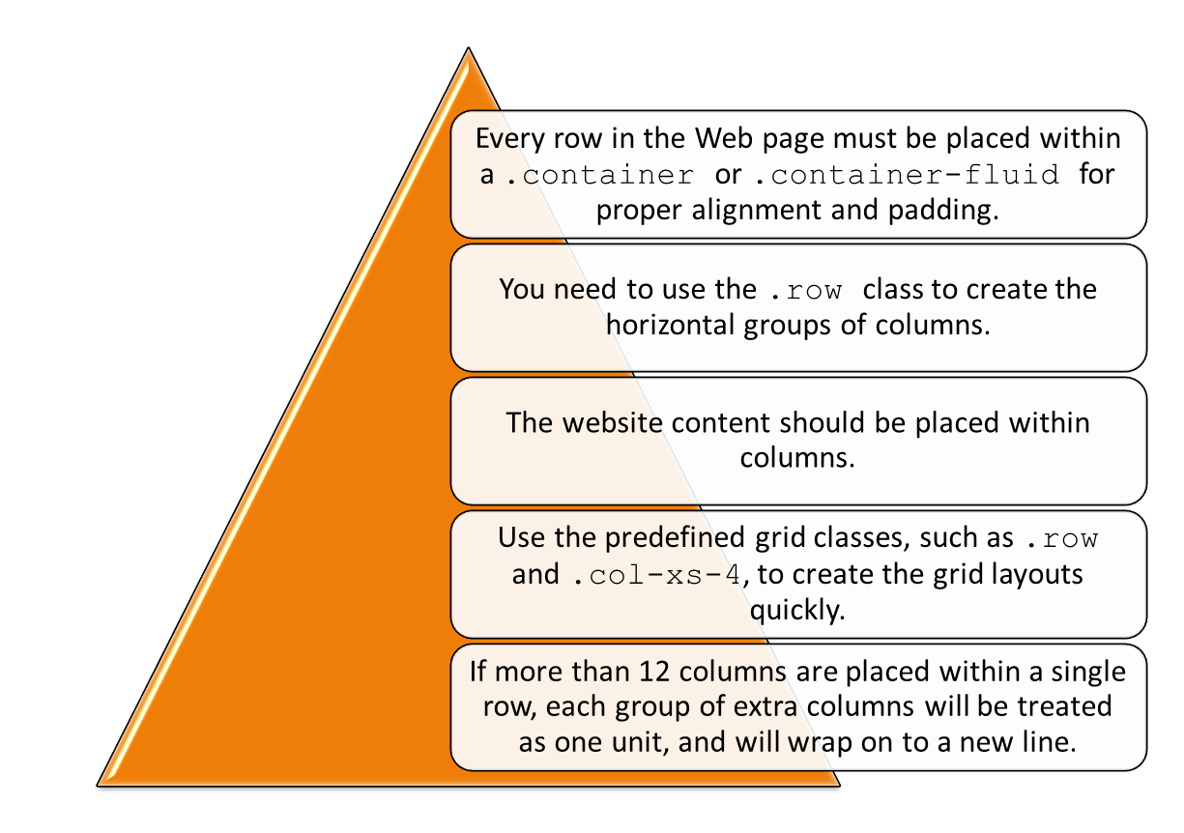
Understanding Grid System (Contd.)
You also need to consider the following points about the Bootstrap grid system for creating the Web page layout.

Slide 24
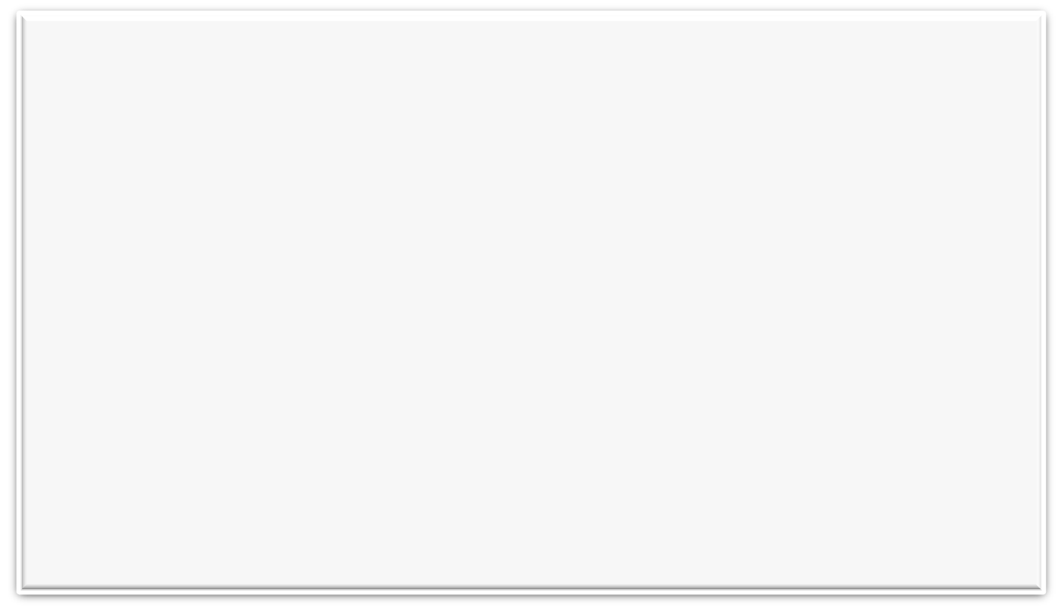
Understanding Grid System (Contd.)
To create a Web page layout consisting of rows and columns using the Bootstrap grid system, you need to use the following code snippet:
<div class="container">
<div class="row" id="siteheader">
<h1> Header</h1>
</div>
<div class="row" id="contentsection">
<div class="col-xs-12 col-sm-9" id="leftpane">
<h3>Content</h3>
<br><br><br><br><br><br><br><br><br><br><br><br>
</div>
<div col-xs-12 col-sm-3" id="rightpane"><h3>Sidebar <br> &nbsp;</h3>
<br><br><br><br><br><br><br><br><br><br><br><br>
</div>
</div>
<div class="row" id="sitefooter">
<h5> Footer</h5>
</div>
</div>

Slide 25
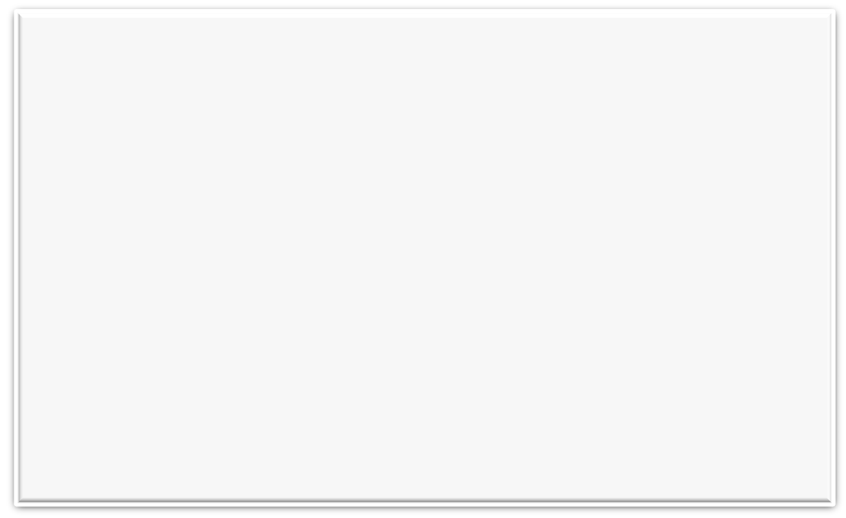
Understanding Grid System (Contd.)
To see rows and columns on a Web page properly, apply some styles to the Web page, as shown in the following code snippet:
.container {
border: 1px solid black; }
#siteheader {
background-color: orange;
height: 130px;
}
#contentsection {
background-color: #fff;
height:auto; }
#sitefooter {
background-color: darkgray;
height: 50px; }
#rightpane {
background-color:#aabbff;
}
#leftpane {
background-color:#ebf5f5;
}

Slide 26
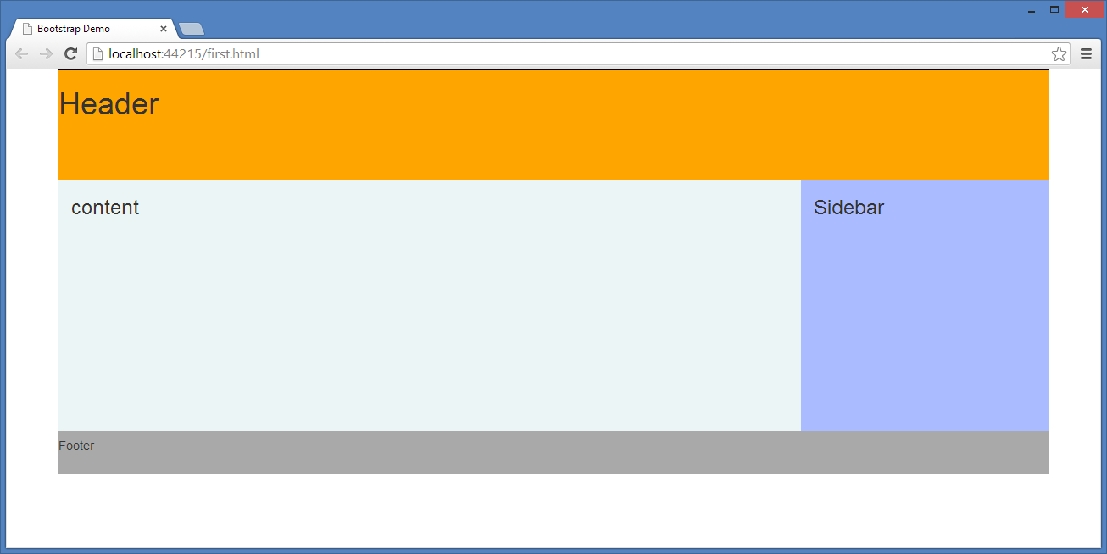
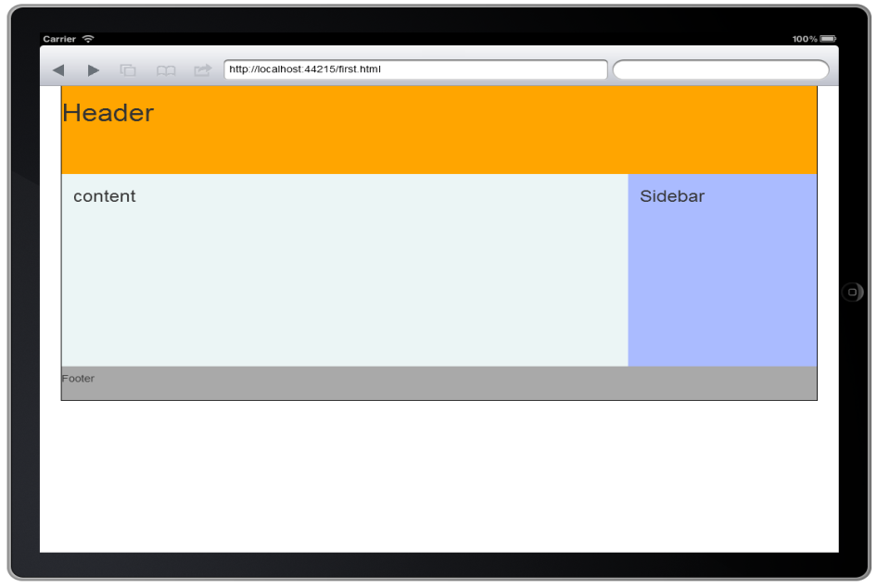
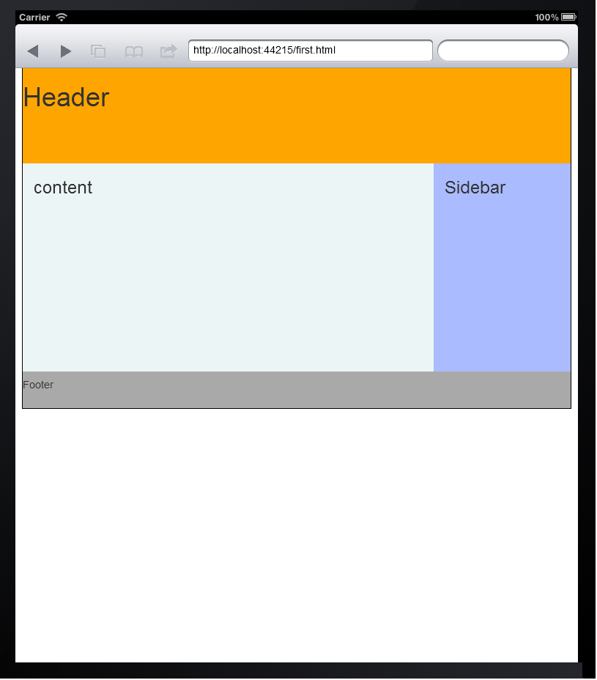
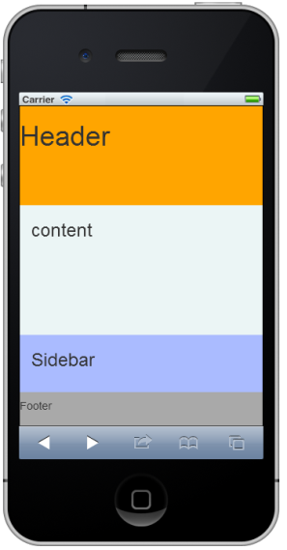
Understanding Grid System (Contd.)
The output of the preceding code snippet on different screen sizes is shown in the following figures.

Slide 27
Adding Built-in Components to Web Pages
Once you have created the layout of a Web page by using the Bootstrap grid system, you can add Bootstrap’s built-in components in the various grid columns.
You can copy the ready-made pieces of code from the following URLs:
  http://getbootstrap.com/css/
  http://getbootstrap.com/components/

Slide 28
Activity: Creating PlanUrTrip Website Using Twitter Bootstrap
You have created a website for PlanUrTrip Private Ltd. in the past, using HTML and CSS. After considering the latest websites trend, the management has decided to give a fresh look to its website. The management approached you to create a responsive website in a shorter period of time. Considering the management’s requirement and keeping the time barrier in mind, you decided to create a responsive website using Twitter Bootstrap. You need to consider the following guidelines while creating the home page of the website:
  Navigation menu should be responsive.
  There must be an image slider on the home page.

Slide 29
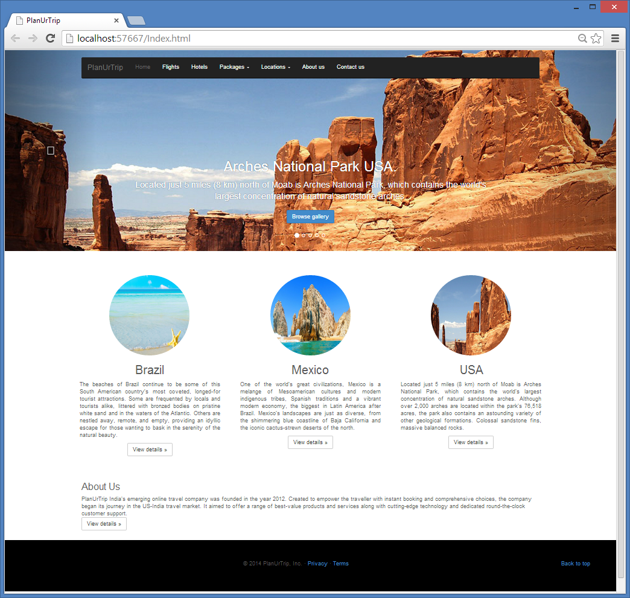
Activity: Creating PlanUrTrip Website Using Twitter Bootstrap (Contd.)
The home page should appear, as shown in the following figures.

Slide 30
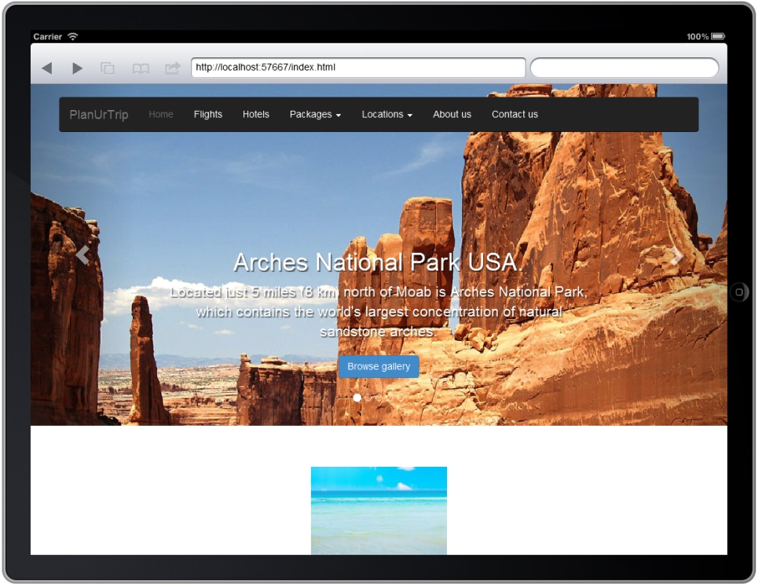
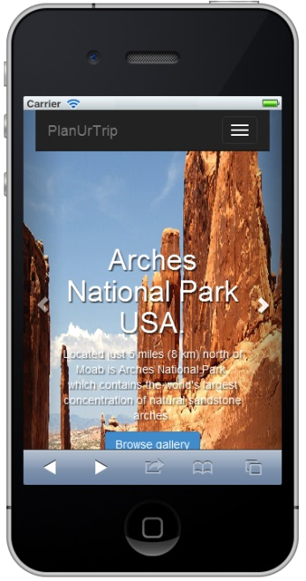
Activity: Creating PlanUrTrip Website Using Twitter Bootstrap (Contd.)
Prerequisite: To perform this activity, you need to use the PlanUrTrip.zip file.

Slide 31
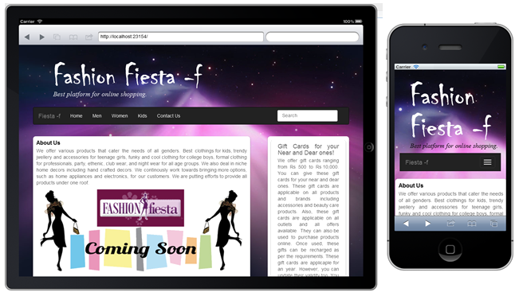
Activity: Creating the Fashion Fiesta Website Using Twitter Bootstrap
You have created a website for Fashion Fiesta Inc. in the past, using HTML and CSS. After considering the latest websites’ trend, the management has decided to give a fresh look to its website. The management has approached you with a task to create a responsive website in a shorter period of time. Considering the management’s requirement and keeping the time barrier in the mind, you have to create a website using Twitter Bootstrap. First, you decided to make the home page of the website responsive.
The home page should appear, as shown in the following figures.

Slide 32
Activity: Creating the Fashion Fiesta Website Using Twitter Bootstrap (Contd.)
Prerequisite: To perform this activity, you need to use the Fashion Fiesta.zip file.

Slide 33
Summary
In this session, you learned that:
  Twitter Bootstrap is one of the most popular front-end frameworks used to create responsive websites.
  It includes HTML and CSS-based design templates and JavaScript plug-ins to create the user interface components, such as forms, buttons, tables, navigations, dropdowns, alerts, and tabs.
  One of the important advantages of using Bootstrap is that it comes with a free set of components, such as navigation bar and other controls, which are used to create flexible and responsive Web layouts.
  Bootstrap can be downloaded in the following modes:
    Compiled Bootstrap
    Bootstrap source
  Bootstrap requires a container to wrap everything contained in the Web page and to house the grid system.
  The following containers are available in Bootstrap:
    .container
    .container-fluid

Slide 34
What’s Next?
After this session, you need to do the following tasks:
  Go through the recorded lecture on the following topic through Cloudscape:
    Introducing Bootstrap
  Perform the following exercises of Chapter 8:
    Exercise 1
    Exercise 2
  Attend Cycle Test 6

